Slide 1
Governance In(clusive) Education
Erasmus+ project KA220-HED - Cooperation partnerships in higher education
AGREEMENT NUMBER – 2021-1-AT01-KA220-HED-000032205
Consortium Meeting ON SITE Leipzig, Thursday 25.01.2024 – Friday 26.01.2024 – Saturday 27.01.2024 (optional for project-teams)

Slide 2

2. Goals
Intellectual Outputs:
Network-Analyses (O1)
Module for Professionalisation (O2)
Open Educational Resource (O3)
How and why coordination or implementation does or does not work in all levels of the governance system (multi-level-analyses of governance).
Finding knowledge and expertise that can be shared in networks between stakeholders and be implemented in professionalization of stakeholders (policy, school-administration, school-boards, principals, ...).
2
Notes:
Developed in 2018 as part of a Pilot Study (Merz-Atalik & Beck 2020; 2023)
Based on an adapted form of the Structure-Lying Techniques according to Scheele & Groeben (1988), Scheele (1992) and Merz-Atalik (2001)
Dialogical Procedure in so-called Round-Table Meetings to develop a cartography of structures in the governance network.
Audio & Video Recording of the whole process for Transcription afterwards
Cartography is transferred into a digital format afterwards

Slide 3
2. What?
How is the “global objective” of inclusive education addressed in four different school administration regions of Europe?
How has the (inclusive school) reform impacted structures and organisations?
Which interest groups are having an impact on the transformation process on the governance level, and how?
How are basic rights (UNCRPD) or the rights of different actors and stakeholders secured and anchored in the governance concept?
Which interdependencies, attitudes or communication structures between levels and / or individual actors are influencing the transformation?
How has the reform process, the network structure, the communication have to be shaped?
How can governance strategies be developed and implemented, that are supporting inclusive education development?
3

Slide 4
2. Why?
To improve transnational, inter-level and inter-actor cooperation in the field of educational governance of inclusive education reforms.
To empower relevant agents and stakeholders in the European education systems.
To initiate actions towards an inclusive education reform in school systems by understanding the means of efficient and effective governance strategies.
To benefit from a greater awareness of the challenges and options and underlying obstacles in the governance of the whole system.
4

Slide 5

2. Who?
Parliament / State Ministry
Upper School Administration/ Department of Education/ Education Directory
Lower School-Administration/ Educational Inspection (Regional)
Educational services (for example: psycho-pedagogical
counselling teams and pedagogical resource centres)
School and teacher management institutions
Parents' associations
Student associations
Associations related to inclusive education
Teacher education and training institutions
Principals from schools, which are working inclusively
Teacher/s from schools, which are working inclusively
Welfare institutions (as far as they are involved
into the resource management or financial aid for the schools)
Image: Cavaliere 2023
5

Slide 6
O2 – Curricular activities
The project focus is on network analyses and involvement of all relevant actors and stakeholders in the context of inclusive education transformation processes and ongoing reform efforts in the participating countries.
The governance constellations, processes, coordination e.g., and the individual experiences of the actors involved will be analyzed and compared.
O1 Multilevel network analyses
O2 Curriculum for training
O3 Web-based
e-Learning and information platform

Slide 7
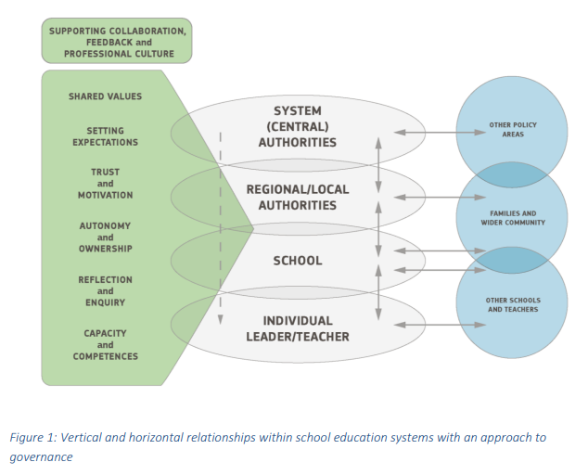
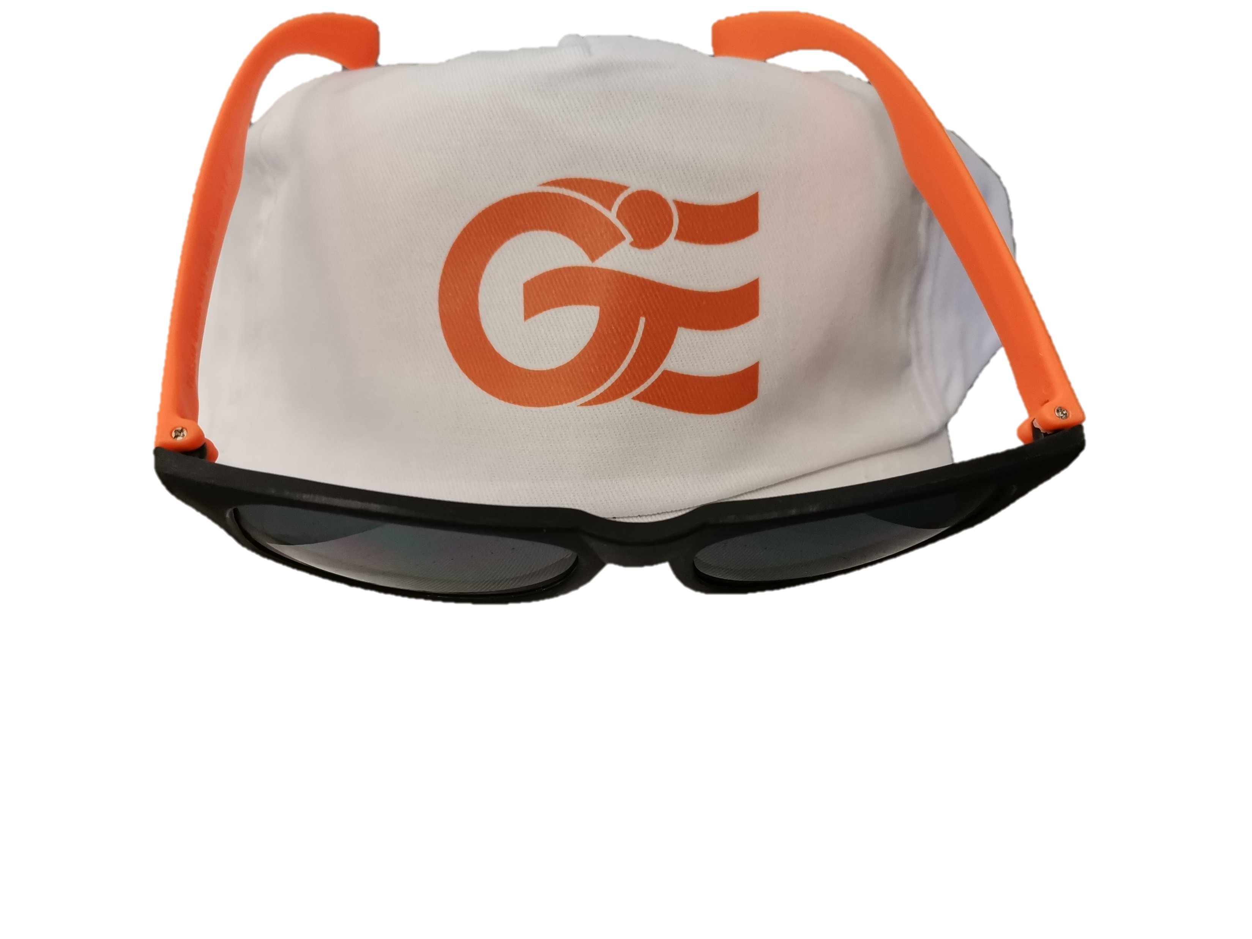
Dimensions of governance processes (Ebersold & Meijer 2016; EU Commission 2018)
10:30 Conclusion templates (partners)
feedback
regulations
visions
compartmentalisation
coordination
collaboration
decisions

Slide 8
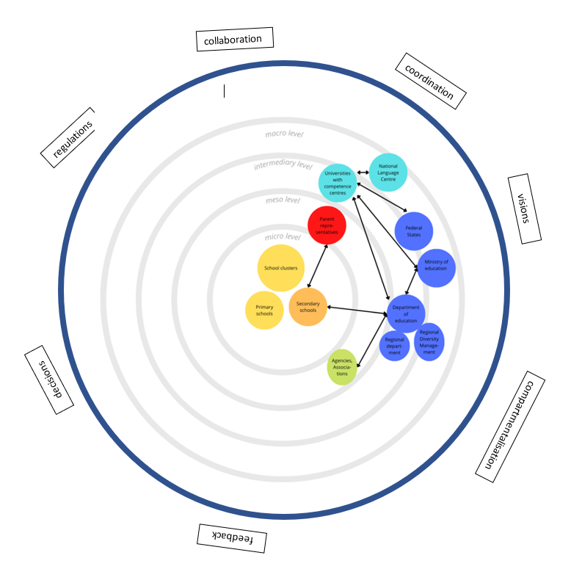
Curriculum: Findings O1

Slide 9

NEW: Community of development
https://www.instagram.com/governanceined/

Slide 10
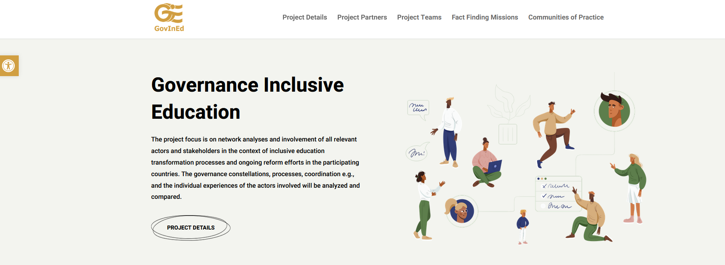
www.govined.eu
Notes:
https://chat.openai.com/
silvia.kopp-sixt@phst.at
Hasnerplatz12

Slide 11



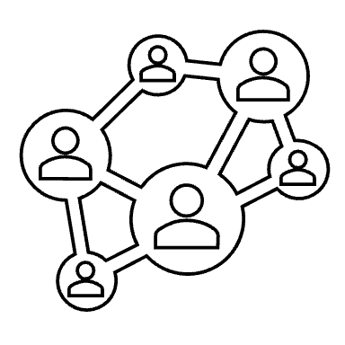
Usability and accessibility for all
Accessibility
Usability
Barrier sensitiveness
Webpage
Events
Newsletter
Community
11

Slide 12
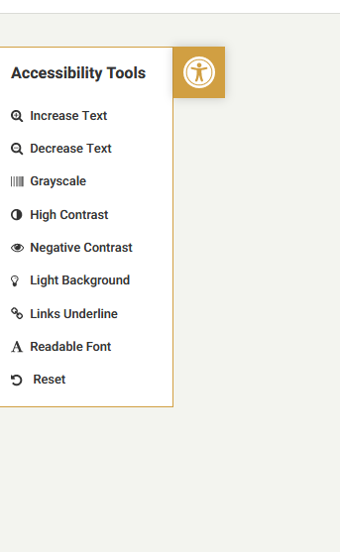





Usability and accessibility for all
https://sway.office.com/318QFRZ86nfJYCPg?ref=Link
12
Notes:
Webpage
Newsletter
Events – special needs support and additional funding

